Slide 1
WEATHER BASED SMART HOME ENERGY CONSUMPTION PREDICTION USING MACHINE LEARNING
PRABANCHAN CHANTHERAN VETHATHIRI

Slide 2
INTRODUCTION
Smart homes and Smart buildings are gaining more and more popularity due to the positive impact and comfort they are adding to people’s lives.
It is also becoming easy to collect information about energy consumption in Internet of Things based smart homes as well as in buildings.
Data can serve for many purposes such as predicting short term/medium term/long time energy consumption.
The prediction can also help energy suppliers plan accordingly with the goal of better load balancing or adjusting the energy production as needed and therefore meeting the customers’ needs.

Slide 3
CURRENT PROBLEM
The fluctuations of energy pricing, the electricity bills for many households is becoming an increasing burden in the monthly bills to be paid.
The energy consumption prediction are challenging due to the fact that energy related data presents nonlinear patterns which is due to a changing weather and climate conditions, populations, and agile seasonal environment.

Slide 4
OBJECTIVES
To analyse and understand the impact of weather conditions, appliances usage on smart home energy consumption.
To develop a machine learning model which provides better accuracy in forecasting the smart home energy consumption based on weather conditions, and appliances usage.

Slide 5
DATASET
The smart home dataset used in this project is retrieved from Kaggle.
In a smart home context, the dataset captures smart metre reporting of house appliance power use, total power consumption, and weather conditions.
The dataset is provided in minute frequency containing 503910 entries contributing to 350 days of information.

Slide 6
Methodology
Data Pre-processing
Data Analysis and Visualization
Feature Transformation
Data Splitting
ML models
Prediction and Evaluation

Slide 7
Data Pre-Processing
One of the most significant data mining activities is data pre-processing, which entails preparing and transforming data into a format appropriate for analysis.
The dataset’s last row having NaN values were removed.
The columns Furnace and Kitchen were present multiple times, they were summed up and combined into a new column.
There were some duplicate columns present in the dataset – House Overall, Gen Solar. Those were removed.
Conversion of Date-Time information from object data type to datetime64[ns] data type using pd.to_datetime function.

Slide 8
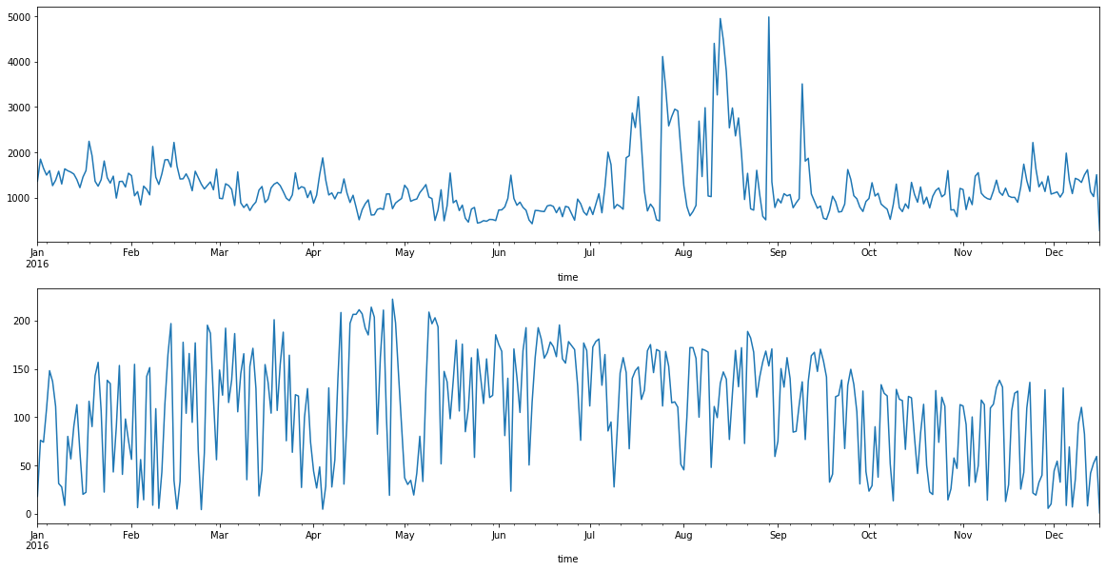
Energy consumption and generation
Data Analysis & Visualization
Line chart representing Energy Consumption and Generation

Slide 9
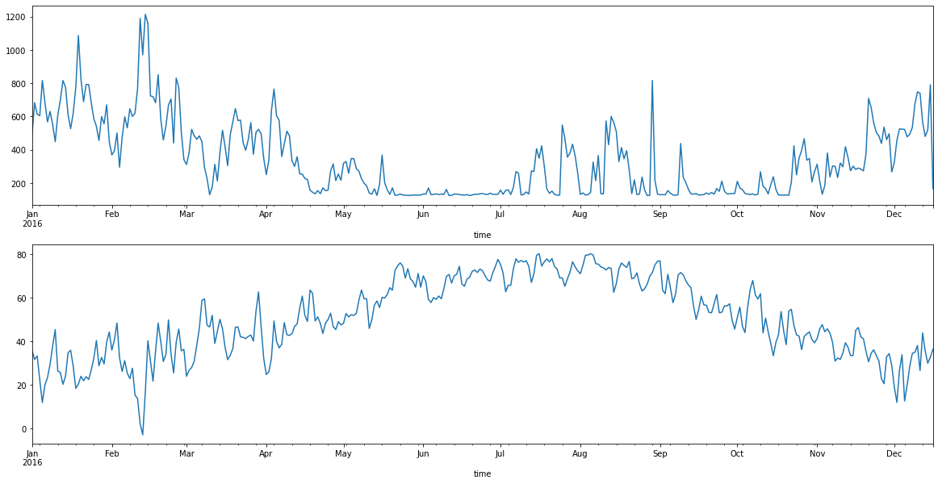
Energy consumed by Furnace Vs Temperature Recorded
Line chart representing energy consumed by furnace and temperature.

Slide 10
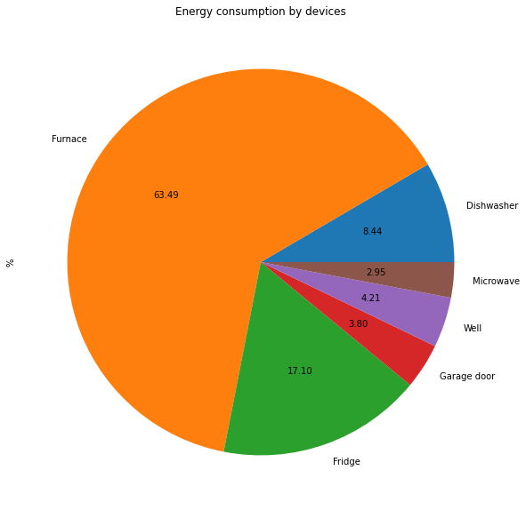
Percentage of Energy Consumption by Devices
Pie chart representing the percentage of energy consumed by each devices in the smart home.

Slide 11
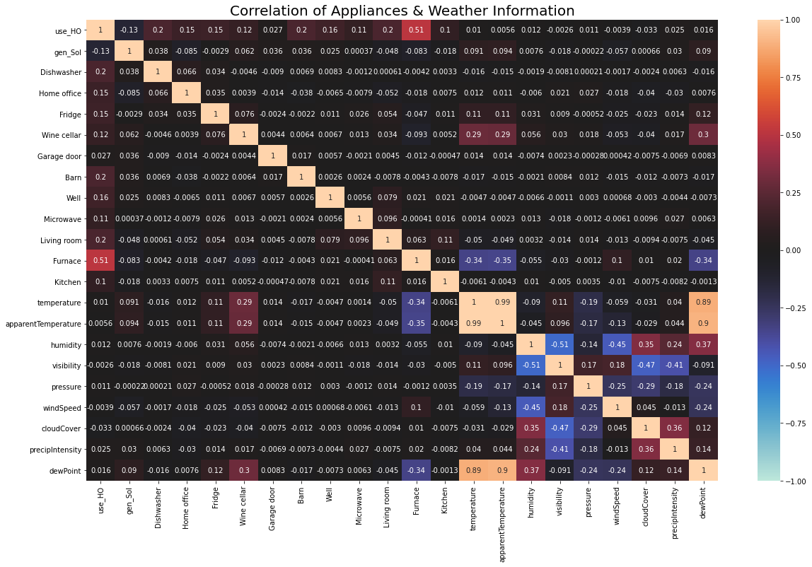
Correlation of Appliances & Weather Information

Slide 12
Feature Transformation
Feature transformation is the process of modifying the data into a form which will make machine learning algorithms train faster and improves prediction accuracy.
Standard Scaler
It normalises each characteristic by subtracting the mean from it and scaling the variance to the value of one.
Principal Component Analysis
PCA was performed on this dataset with explained variance as 95% to reduce the dimensionality.

Slide 13
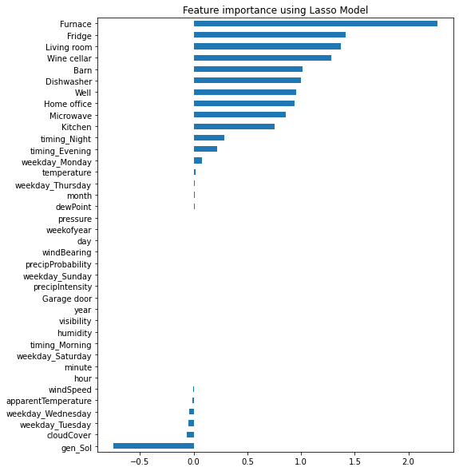
Feature Importance using Lasso Regression

Slide 14
Data Splitting
The dataset containing 346 days of the smart home information was split as training data for fitting the machine learning models.
The remaining four days of information was considered for prediction and evaluation of the models.

Slide 15
Machine Learning Models
Support Vector Regression
Linear Regression
Decision Tree Regressor
Random Forest Regressor
k Nearest Neighbors Regressor
Neural Networks

Slide 16
Model Prediction and Evaluation
Before Resampling (Minute Frequency)
After Resampling
(Daily Frequency)
Model | Mean Absolute Error (MAE) | Mean Squared Error (MSE) | Root Mean Squared Error (RMSE)
Support Vector Regression | 0.13 | 0.37 | 0.19
Linear Regression | 0.42 | 0.28 | 0.53
Random Forest Regressor | 0.17 | 0.07 | 0.26
Decision Tree Regressor | 0.25 | 0.16 | 0.39
kNeighbors Regressor | 0.15 | 0.04 | 0.21
Neural Networks | 0.11 | 0.02 | 0.14
Model | Mean Absolute Error (MAE) | Root Mean Squared Error (RMSE)
Support Vector Regression | 30.96 | 40.15
Linear Regression | 301.38 | 335.73
Random Forest Regressor | 126.61 | 150.66
Decision Tree Regressor | 85.50 | 104.48
kNeighbors Regressor | 37.89 | 48.99
Neural Networks | 45.54 | 58.97

Slide 17
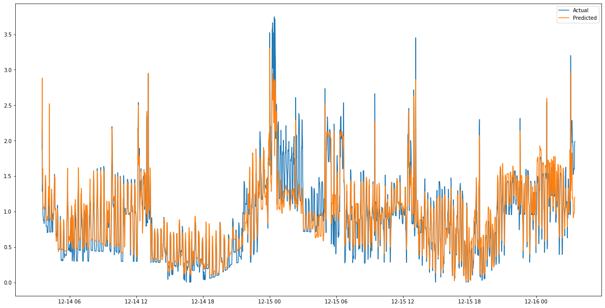
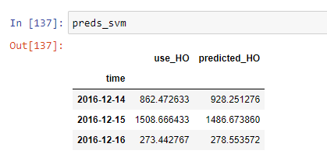
Support Vector Regression Forecast
Actual energy consumed Vs predicted energy consumption.

Slide 18
Conclusion and Future Work
Out of the six models used to forecast the future energy consumption in the smart home, Support Vector Regression model performed efficiently while forecasting
The support vector regression model performed with an error rate (RMSE) of 40.15 when forecasting two days ahead, and with an error rate (RMSE) of 115.78 when forecasting seven days of energy consumption ahead.
The framework proposed in this paper can be beneficial for both utility companies, consumers, and also to the environment.
The performance of the model can be improved in the future for better forecast results by gathering accurate weather information from meteorological institution, and by hyper parameter tuning the model.

